Slide 1
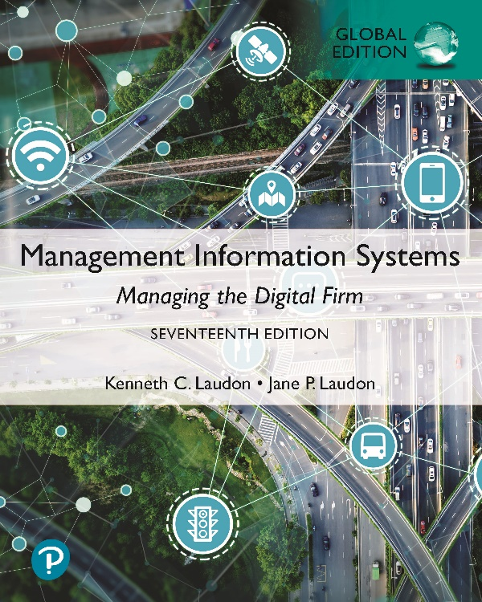
Management Information Systems: Managing the Digital Firm
Seventeenth Edition, Global Edition
Chapter 1
Information Systems in Global Business Today
Copyright © 2022, 2020, 2018 Pearson Education, Ltd. All Rights Reserved
Notes:
If this PowerPoint presentation contains mathematical equations, you may need to check that your computer has the following installed:
1) MathType Plugin
2) Math Player (free versions available)
3) NVDA Reader (free versions available)

Slide 2
Learning Objectives
1.1 How are information systems transforming business, and why are they so essential for running and managing a business today?
1.2 What is an information system? How does it work? What are its management, organization, and technology components? Why are complementary assets essential for ensuring that information systems provide genuine value for organizations?
1.3 What academic disciplines are used to study information systems, and how does each contribute to an understanding of information systems?
1.4 How will MIS help my career?
Notes:
This chapter introduces information systems in "global business." Students may not know exactly what is meant by globalization or may have an incomplete understanding of the term. You might ask students what they think it means. Potential answers could include reduction of economic and cultural advantages of developed countries, increased number of companies with operations in multiple countries worldwide, and increased reliance on imports and exports of goods (and jobs). Globalization will be discussed in later slides as well.

Slide 3
Video Cases
Case 1: Business in the Cloud: Facebook, Google, and eBay Data Centers
Case 2: U P S Global Operations with the D I A D and Worldport
Instructional Video: Tour I B M’s Raleigh Data Center

Slide 4
Smart Stores Reinvent the Retail Space (1 of 2)
Business Challenges
  Mounting competition from online retailers
  Take advantage of opportunities provided by new technology
Solutions
  Acrelec system helps stores manage curbside pickup
  AWM Smart Shelf enables retailers to view and track products in real-time; helps shoppers locate products using mobile devices; personalizes shopper experiences
  AWM Frictionless enables low-contact cashierless checkout

Slide 5
Smart Stores Reinvent the Retail Space (2 of 2)
Illustrates how brick-and-mortar retail stores are using information technology to compete more effectively against online retailers
Demonstrates I T’s role in driving business operations and management decisions
Illustrates how deploying new technology requires companies to redesign jobs and procedures, changing how companies run their businesses

Slide 6
How Information Systems Are Transforming Business
Global spending on information technology (IT) and IT services: nearly $3.8 trillion in 2019; $160 billion spent on management consulting and services
Organizational, management, and cultural changes are often required for firms to derive full business value from IT investments

Slide 7
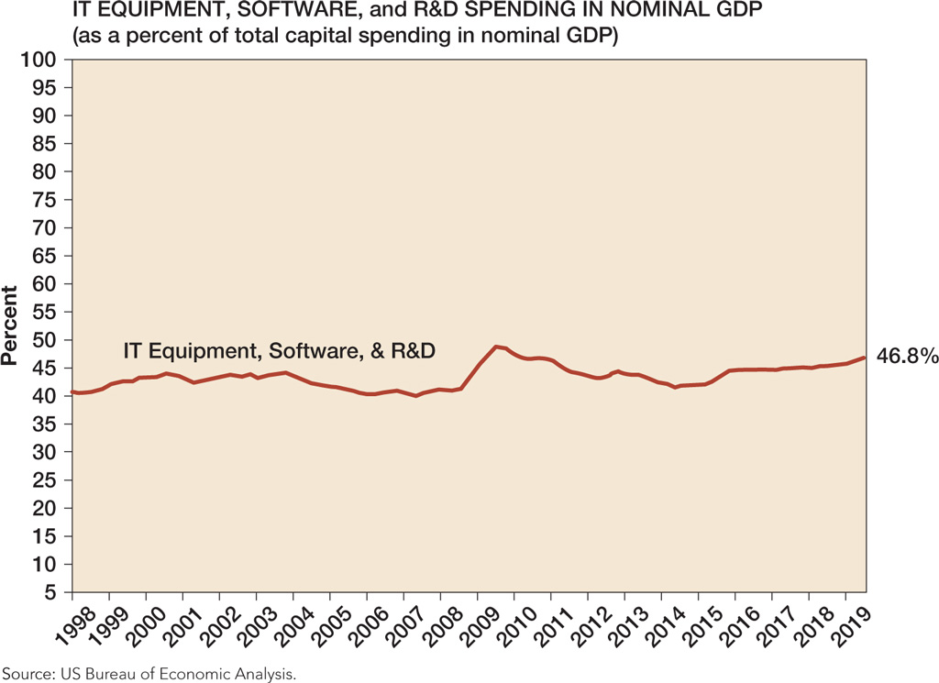
Figure 1.1 Information Technology Capital Investment
Notes:
Figure 1.1, Page 6.
Information technology capital investment, defined as IT equipment, software, and research and development (R & D) spending, amounted to over 40 percent of total US capital spending (in nominal GDP) between 1999 and 2019.
Source: US Bureau of Economic Analysis.
You could ask students why they think the percentage of total investment devoted to IT has amounted to over 40 percent of total U.S. capital spending each year from 1998 to 2019. Other kinds of capital investment are machinery and buildings. Why would firms continue to spend so much on IT investment? Part of the answer is capital substitution: the price of IT capital has been falling exponentially, whereas the price of machine and buildings has been growing at slightly more than the rate of inflation. Wherever possible, firms would much rather invest in more IT than machinery or buildings because the returns on the investment are greater.
Alt Text
Long description: A line graph shows the IT equipment, software, and R&D spending in nominal GDP over the years. The details of the graph are as follows:
The x-axis shows the year from 1998 to 2019 in increments of 1.
The y-axis shows the percent of spending as a percent of total capital spending in nominal GDP, ranging from 5 to 100 in increments of 5.
The graph shows that the curve starts at about 41 percent in 1998 and remains between 40 and 45 percent till around 2008. It then peaks to about 50 percent between 2009 and 2010 and then dropped. It was last recorded at 46.8 percent in 2019.

Slide 8
What’s New in Management Information Systems (1 of 3)
I T Innovations
  Cloud computing, big data, Internet of Things
  Mobile digital platform
  AI and machine learning
  Use of social networks for business objectives
New Business Models
  Online streaming and downloadable video
    Examples: Netflix, Apple TV Channels, Amazon

Slide 9
What’s New in Management Information Systems (2 of 3)
E-commerce Expansion
  E-commerce worldwide expands to nearly $3.6 trillion in 2019
  Growth in social commerce spurred by growth of mobile platform
  Mobile retail e-commerce growing more than 20 percent a year, reaching almost $300 billion in 2020
Management Changes
  Managers becoming more mobile
  Managers use social networks, collaboration tools
  Business intelligence applications accelerate

Slide 10
What’s New in Management Information Systems (3 of 3)
Firms and Organizations Change
  More collaborative, less emphasis on hierarchy and structure
  Greater emphasis on competencies and skills
  Higher-speed/more accurate decision making based on data and analysis
  More willingness to interact with consumers (social media)
  Better understanding of the importance of I T

Slide 11
Interactive Session: Management: Will the Coronavirus Pandemic Make Working from Home the New Normal? (1 of 2)
Class Discussion
  Define the problem described in this case. What are the management, organization, and technology issues raised by this problem?
  Identify the information technologies used to provide a solution to this problem. Was this a successful solution? Why or why not?
Notes:
The COVID-19 pandemic has impacted almost all aspects of life, requiring not only remote work, as discussed in the Interactive Session, but also remote learning. Ask students to share their experiences with remote learning (and/or remote work). What challenges does it pose? What benefits?

Slide 12
Interactive Session: Management: Will the Coronavirus Pandemic Make Working from Home the New Normal? (2 of 2)
Class Discussion
  Will working from home become the dominant way of working in the future? Why or why not?.

Slide 13
Globalization Challenges and Opportunities: A Flattened World
Internet and global communications have greatly changed how and where business is done
  Drastic reduction of costs of operating and transacting on global scale
  Competition for jobs, markets, resources, ideas
  Growing interdependence of global economies
  Requires new understandings of skills, markets, opportunities
Notes:
Ask your students about their experience and thoughts about globalization. Ask them how they might react if they learned that a job opening they coveted was outsourced to another country, or on the other hand, what they would do if they were managers filling a job opening and workers from abroad could fill the spot for a fraction of the cost? Benefits of globalization: how would they feel about paying 50% more for their clothing that was made domestically in the U.S.?

Slide 14
The Emerging Digital Firm
In a fully digital firm:
  Significant business relationships are digitally enabled and mediated
  Core business processes are accomplished through digital networks
  Key corporate assets are managed digitally
Digital firms offer greater flexibility in organization and management
  Time shifting, space shifting
Notes:
Time shifting and space shifting are connected to globalization. You could ask students to explain why a digital firm is more likely to benefit from globalization than a traditional firm. One answer is that by allowing business to be conducted at any time (time shifting) and any place (space shifting), digital firms are ideally suited for global operations which take place in remote locations and different time zones.

Slide 15
Strategic Business Objectives of Information Systems (1 of 2)
Growing interdependence between:
  Ability to use information technology
  Ability to implement corporate strategies and achieve corporate goals
Notes:
Ask students to describe their personal experience, if any, with new information systems being introduced to their workplace.

Slide 16
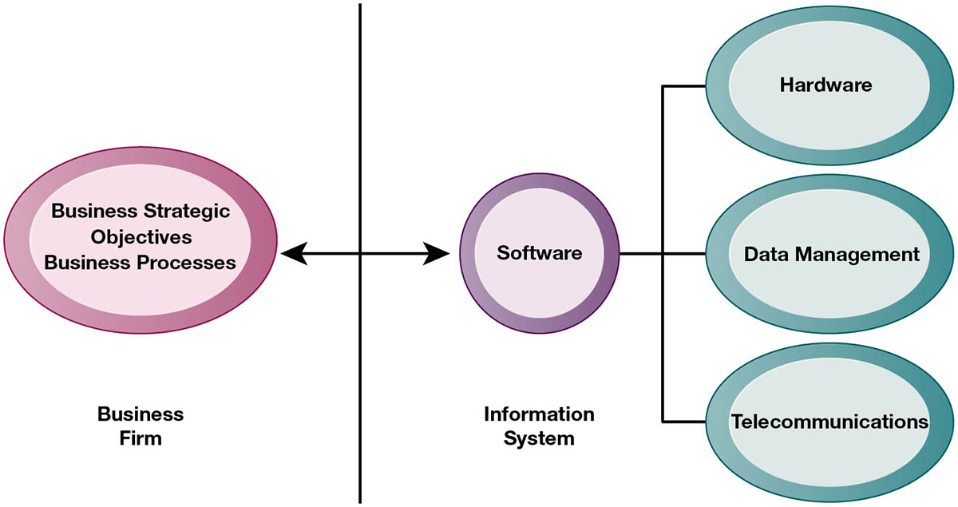
Figure 1.2 The Interdependence Between Organizations and Information Systems
Notes:
Figure 1.2, Page 12.
In contemporary systems, there is a growing interdependence between a firm’s information systems and its business capabilities. Changes in strategy, rules, and business processes increasingly require changes in hardware, software, databases, and telecommunications. Often, what the organization would like to do depends on what its systems will permit it to do.
The basic point of this graphic is that in order to achieve its business objectives, a firm most likely will need a significant investment in IT. Going the other direction (from right to left), having a significant IT platform can lead to changes in business objectives and strategies. Emphasize the two-way nature of this relationship. Businesses rely on information systems to help them achieve their goals; a business without adequate information systems will inevitably fall short. But information systems are also products of the businesses that use them. Businesses shape their information systems and information systems shape businesses.
Alt Text
Long description: A flow diagram shows the interdependence between organizations and information systems. The flow diagram is as follows:
Level 1: Business firm; business strategic objectives business processes are interchangeably dependent on software
Level 2: Information system; software is dependent on the following:
Hardware
Data management
Telecommunications

Slide 17
Strategic Business Objectives of Information Systems (2 of 2)
Firms invest heavily in information systems to achieve six strategic business objectives:
  Operational excellence
  New products, services, and business models
  Customer and supplier intimacy
  Improved decision making
  Competitive advantage
  Survival
Notes:
When discussing the cases and Interactive Sessions throughout the book, it will be useful to ask students to explain how various information systems succeeded or failed in achieving the six strategic business objectives. You might ask the students to think about some other business objectives and think about how IT might help firms achieve them. For instance, speed to market is very important to firms introducing new products. How can IT help achieve that objective?

Slide 18
Operational Excellence
Improved efficiency results in higher profits
Information systems and technologies help improve efficiency and productivity
Example: Walmart
  Power of combining information systems and best business practices to achieve operational efficiency—and over $524 billion in sales in 2019
  Most efficient retail store in world as result of digital links between suppliers and stores
Notes:
Walmart is the most efficient retailer in the industry and exemplifies operational excellence. You could ask students to name other businesses that they believe exhibit a high level of operational excellence. Do customers perceive operational excellence? Does it make a difference for customer purchasing? What websites strike students as really excellent in terms of customer service? If you have a podium computer, you might want to visit the Walmart site and the Amazon site to compare them in terms of ease of use.

Slide 19
New Products, Services, and Business Models
Information systems and technologies enable firms to create new products, services, and business models
Business model: how a company produces, delivers, and sells its products and services
Example: Apple
  Transformed old model of music distribution with iTunes
  Constant innovations—iPod, iPhone, iPad, etc.
Notes:
You could ask students to name other new products or business models that they have encountered and how they might relate to new information systems or new technology. One way to encourage participation is ask students to help you list some interesting recent digital product innovations. Discussing “green technologies” such as wind, solar, and hybrid or electric vehicles usually sparks student interest. In this context, what role will IT be playing in the development of these technologies?

Slide 20
Customer and Supplier Intimacy
Customers who are served well become repeat customers who purchase more
  Example: Mandarin Oriental Hotel
  Uses I T to foster an intimate relationship with its customers, keeping track of preferences, etc.
Close relationships with suppliers result in lower costs
  Examples: Mandarin Oriental Hotel and J C Penney (in text)
  J C Penney uses I T to enhance relationship with supplier in Hong Kong
Notes:
You could ask students what types of companies might rely more on customer and supplier intimacy more than others and which companies they feel have served them exceptionally well. Ask the students to identify online sites that achieve a high degree of customer intimacy. Sites to visit would include Netflix, Amazon, and other sites which have recommender systems to suggest purchase ideas to consumers.

Slide 21
Improved Decision Making
Without accurate information, managers must use forecasts, best guesses, and luck, resulting in misallocation of resources, inventory, employees
Real-time data improves ability of managers to make decisions
  Example: Verizon’s web-based digital dashboard to provide managers with real-time data on customer complaints, network performance, line outages, etc.
Notes:
You could ask students if they have ever been recipients of exceptional service from a company made possible by improved decision making and whether or not information systems contributed to that level of service.

Slide 22
Competitive Advantage
Often results from achieving previous business objectives
Advantages over competitors
  Charging less for superior products, better performance, and better response to suppliers and customers
  Examples: Apple, Walmart, U P S are industry leaders because they know how to use information systems for this purpose
Notes:
Emphasize that achieving any of the previous four business objectives (operational excellence; new products, services, and business models; customer and supplier intimacy; and improved decision making) represents the achievement of a competitive advantage as well.

Slide 23
Survival
Businesses may need to invest in information systems out of necessity; it is simply the cost of doing business
Keeping up with competitors
  Citibank’s introduction of A T Ms
Federal and state regulations and reporting requirements
  Toxic Substances Control Act and the Sarbanes-Oxley Act
Notes:
Ask students if they can name any examples of companies that failed to survive due to unwillingness or inability to update their information systems. If they find this difficult at first, ask them to think about firms where the products or service were really unacceptable.
The Sarbanes-Oxley Act (2002) requires that public firms keep all data, including e-mail, on record for 5 years. The Dodd-Frank Act (2010) requires financial services firms to develop extensive new compliance reports. You could ask students if they appreciate why information systems would be useful toward meeting the standards imposed by these new federal statutes.

Slide 24
What Is an Information System? (1 of 3)
Information technology: the hardware and software a business uses to achieve objectives
Information system: interrelated components that manage information to:
  Support decision making and control
  Help with analysis, visualization, and product creation
Data: streams of raw facts
Information: data shaped into meaningful, useful form
Notes:
It's important to understand that information systems are not just technologies, but deeply involve people and organizations as well. Being a great programmer does not qualify you for being a great manager of information systems.
Ask students to think of a stream of raw facts (data), and then an organized body of data (information). A stream of facts example is the “ticker tape” of a stock market (you can go to a website to display the streaming stock prices). Summary indices of stock movements and reports on stock groups (e.g. housing, transportation) or market indices like the S&P 500 constitute information.

Slide 25
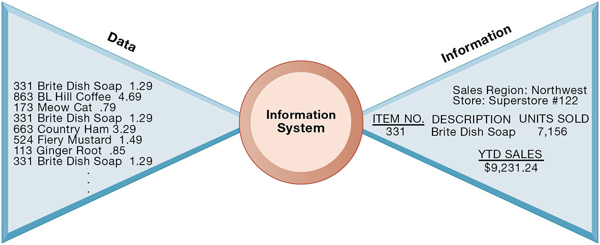
Figure 1.3 Data and Information
Notes:
Figure 1.3, Page 15.
Raw data from a supermarket checkout counter can be processed and organized to produce meaningful information, such as the total unit sales of dish detergent or the total sales revenue from dish detergent for a specific store or sales territory.
Emphasize the distinction between information and data. You could, for example, ask several students to list their ages and record their answers—then you could calculate the average age of those students on the other side, oldest student, youngest student, and so forth, to illustrate the difference between raw data and meaningful information.
Alt Text
Long description: A butterfly flow diagram illustrates how an information system converts data into information. The flow diagram shows the data that is input into an information system on the left and the information that is obtained on the right.
The data input is as follows:
331 Brite Dish Soap: 1.29
863 BL Hill Coffee: 4.69
173 Meow Cat: .79
331 Brite Dish Soap: 1.29
663 Country Ham: 3.29
524 Fiery Mustard: 1.49
113 Ginger Root: .85
331 Brite Dish Soap: 1.29
The information obtained is as follows:
Sales Region: Northwest
Store: Superstore number 122
Item number: 331
Description: Brite Dish Soap
Units sold: 7,156
YTD sales: 9,231.24 dollars.

Slide 26
What Is an Information System? (2 of 3)
Activities in an information system that produce information:
  Input
  Processing
  Output
  Feedback
Sharp distinction between computer or computer program versus information system
Notes:
Use an example similar to the one given in the previous slide to illustrate the three activities involved in the function of an information system. Continuing with that example, the process of asking students their age would represent input, calculating the average age and determining the oldest and youngest age would represent processing, and displaying that information in a report would represent output.

Slide 27
What is an Information System? (3 of 3)
Feedback
  Output is returned to appropriate members of organization to help evaluate or correct input stage
Computer/computer program vs. information system
  Computers and software are technical foundation and tools, similar to the material and tools used to build a house
Notes:
Explain to students how the “house” analogy works: assuming that a successful information system is like a completed “house,” computers and software represent only the tools and materials used to build the house. Tools and materials don’t just suddenly become a completed house—outside (human) input is required. Systems need to be designed to fit the firms and the humans who work with the systems.

Slide 28
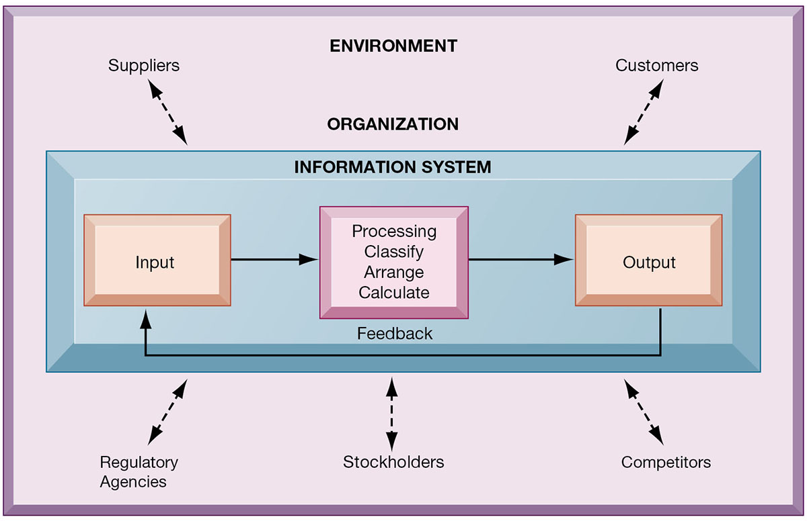
Figure 1.4 Functions of an Information System
Notes:
Figure 1.4, Page 16.
An information system contains information about an organization and its surrounding environment. Three basic activities—input, processing, and output—produce the information organizations need. Feedback is output returned to appropriate people or activities in the organization to evaluate and refine the input. Environmental actors, such as customers, suppliers, competitors, stockholders, and regulatory agencies, interact with the organization and its information systems.
The point of this diagram is first of all to highlight the three basic activities of information systems, so that students can understand what an information system is doing at its most fundamental level. But the diagram also puts information systems into the context of organizations (firms), and then puts the firm into its respective environment composed of shareholders, higher level authorities (government), competitors, suppliers, and customers. Suddenly, students should see that information systems play a central role mediating and interacting with all these players. Hence, systems play a key role in the operations and survival of the firm.
You could also explain this diagram by relating it back to the opening case, as the book does.
Alt Text
Long description: A figure illustrates basic activities of an information system at an organization level and the environmental actors interacting with the organization and its information system.
The basic activities of the information system of an organization are as follows:
Input
Processing, which includes classify, arrange, and calculate
Output, which provides feedback to input
The environmental actors interacting with the organization are as follows:
Suppliers
Customers
Regulatory agencies
Stockholders
Competitors

Slide 29
Dimensions of Information Systems
Organizations
Management
Technology

Slide 30
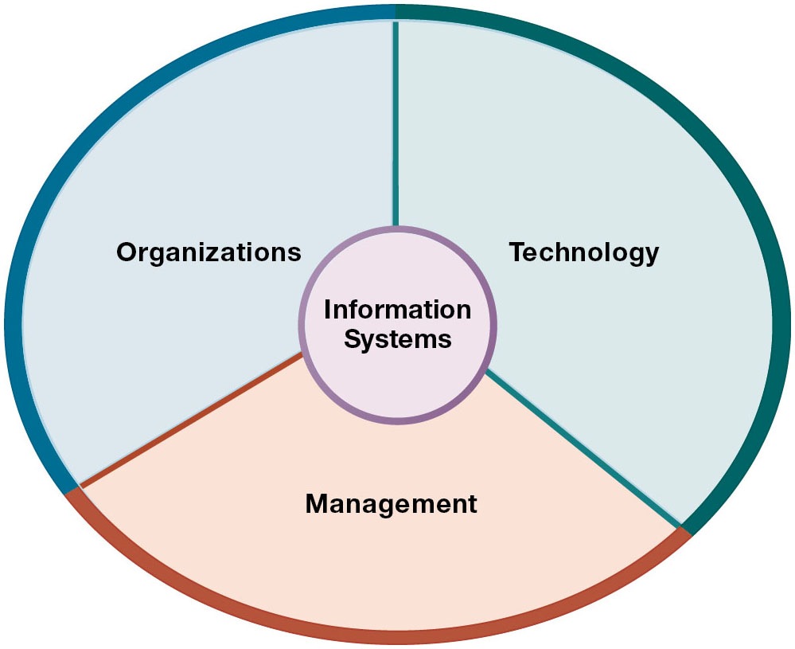
Figure 1.5 Information Systems Are More Than Computers
Notes:
Figure 1.5, Page 17.
Using information systems effectively requires an understanding of the organization, management, and information technology shaping the systems. An information system creates value for the firm as an organizational and management solution to challenges posed by the environment.
These three themes (management, organizations, and technology) will reappear throughout the book. Understanding the interaction among these factors and information systems is known as information system literacy. Knowing how to optimize the relationship between technology, organizations, and management is the purpose of this book and course.

Slide 31
Dimensions of Information Systems: Organizations (1 of 2)
Hierarchy of authority, responsibility
  Senior management
  Middle management
  Operational management
  Knowledge workers
  Data workers
  Production or service workers
Notes:
Pages 17 and 18 in the text provide more specific details on each level of this hierarchy. You can ask students to talk about an organization where they currently work or have worked in the past. What was their contact with senior management, middle management, and operational (supervisory) management? Many younger students will have had little or no contact with senior and middle management. Older students most likely will have experience. You might need to provide more description about exactly what senior managers do for the firm (and middle managers).

Slide 32
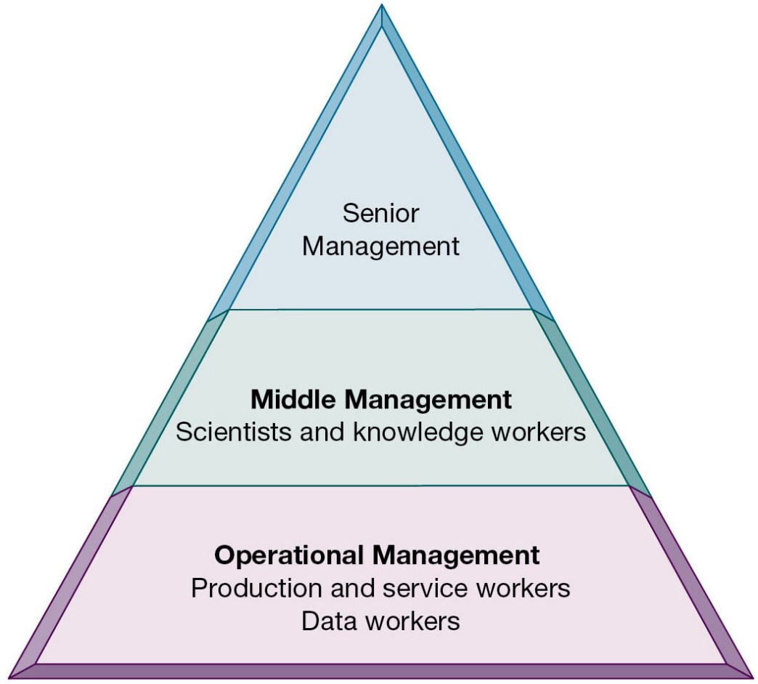
Figure 1.6 Levels in a Firm
Notes:
Figure 1.6, Page 18.
Business organizations are hierarchies consisting of three principal levels: senior management, middle management, and operational management. Information systems serve each of these levels. Scientists and knowledge workers often work with middle management.
Ask students to think about how information systems would factor into the day-to-day jobs of each of the three types of workers in the pyramid.
Alt Text
Long description: A figure shows a pyramid depicting the principal levels in a firm. The pyramid shows the principal levels of a firm from bottom to top as follows:
Operational management: Production and service workers; data workers
Middle management: Scientists and knowledge workers
Senior management

Slide 33
Dimensions of Information Systems: Organizations (2 of 2)
Separation of business functions
  Sales and marketing
  Human resources
  Finance and accounting
  Manufacturing and production
Unique business processes
Unique business culture
Organizational politics
Notes:
The point of this slide is to let students know there are many organizational factors that will shape information systems. A common observation is that “Every business is different.” Does this mean every business will have different information systems? Every business has its unique culture and politics. Systems reflect these business cultures.
For an example of how information systems shed light on a firm’s unique business processes and culture, you might describe the UPS Interactive Session later in the chapter. The company’s package tracking systems exemplify their commitment to customer service and putting the customer first.

Slide 34
Dimensions of Information Systems: Management
Managers set organizational strategy for responding to business challenges
In addition, managers must act creatively
  Creation of new products and services
  Occasionally re-creating the organization
Notes:
How might information systems assist managers in the development of new products and services? What is meant by re-creating the organization? Why do organizations need to be continually re-created? The answer is that they quickly become obsolete unless they continue to change. Ask students to help you list some organizations that have recently failed or are about to fail.

Slide 35
Dimensions of Information Systems: Information Technology
Computer hardware and software
Data management technology
Networking and telecommunications technology
  Networks, the Internet, intranets and extranets, World Wide Web
I T infrastructure: provides platform that system is built on
Notes:
Information technology is at the heart of information systems. Although organization and management are important too, it’s the technology that enables the systems and the organizations and managers who use the technology.

Slide 36
Interactive Session – Technology: Healthcare at Singapore’s JurongHealth Services
Class Discussion
  What technologies are used by JurongHealth? What purpose do they serve?
  Search the web for RFID. Suggest an example of using RFID for locating and tracking people.
  What information systems are implemented by JurongHealth? Describe the input, processing, and output of any one such system.
  Why are information systems important for JurongHealth?
Notes:
UPS is a good example of a company that successfully uses information systems to enhance their business.
Discuss the Delivery Information Acquisition Device (DIAD) and its various uses. Why is it an excellent example of an information system affected by a firm’s business and vice versa? Do students think UPS does a good job with its information systems? What might they improve?

Slide 37
It Isn’t Just Technology: A Business Perspective on Information Systems (1 of 3)
Information system is instrument for creating value
Investments in information technology should result in superior returns
  Productivity increases
  Revenue increases
  Superior long-term strategic positioning
Notes:
You could ask students to consider how this view of information systems might contrast with the sociotechnical view or other views. You could also ask them to consider the circumstances under which information systems might not result in increased productivity and revenue.

Slide 38
It Isn’t Just Technology: A Business Perspective on Information Systems (2 of 3)
Business information value chain
  Raw data acquired and transformed through stages that add value to that information
  Value of information system determined in part by extent to which it leads to better decisions, greater efficiency, and higher profits
Business perspective
  Calls attention to organizational and managerial nature of information systems
Notes:
During this and the next slide, emphasize that the end result of the business information value chain will be profitability.
Questions for students: What aspects of the business perspective might be lacking? Are there other perspectives that might provide a different picture? (sociotechnical)

Slide 39
It Isn’t Just Technology: A Business Perspective on Information Systems (3 of 3)
Investing in information technology does not guarantee good returns
There is considerable variation in the returns firms receive from systems investments
Factors
  Adopting the right business model
  Investing in complementary assets (organizational and management capital)
Notes:
Connect this slide to the previous slide. Many firms make significant investments in IT for very little benefit to the bottom line. Discuss why companies experience a wide variety of outcomes in their efforts to invest in IT. Consider the factors we use in this book: organizational and management factors.

Slide 40
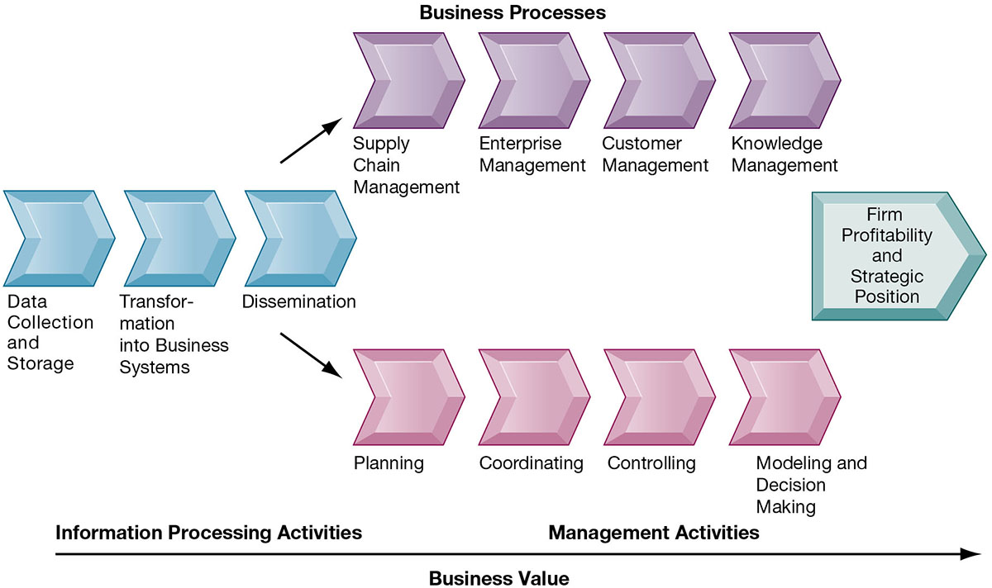
Figure 1.7 The Business Information Value Chain
Notes:
Figure 1.7, Page 23.
From a business perspective, information systems are part of a series of value-adding activities for acquiring, transforming, and distributing information that managers can use to improve decision making, enhance organizational performance, and, ultimately, increase firm profitability.
The information value chain is one way to visualize the relationship among information activities, business processes, and management activities. You could also ask students if they could imagine any reason to create an information system besides profitability or strategic positioning (it’s not likely that they will think of one, which will prove the point). One reason to create a system that is not primarily profit-oriented is to meet the information reporting requirements of government and other authorities.
Alt Text
Long description: A flow diagram shows parts of the business value chain. The business value chain is divided in three sequential parts leading to firm profitability and strategic position. The parts along with activities listed under them are as follows:
Information processing activities
Data collection and storage
Transformation into business systems
Dissemination
Business processes
Supply chain management
Enterprise management
Customer management
Knowledge management
Management activities
Planning
Coordinating
Controlling
Modeling and decision making

Slide 41
Complementary Assets: Organizational Capital and the Right Business Model (1 of 2)
Assets required to derive value from a primary investment
Firms supporting technology investments with investment in complementary assets receive superior returns
Example: Invest in technology and the people to make it work properly
Notes:
The example used in the book for complementary assets is for automobile companies: these companies rely on investments in highways, other roads, gas stations, repair facilities, and so on to maximize the value of their primary investment. Ask students to provide a different example of another company’s or industries complementary assets.

Slide 42
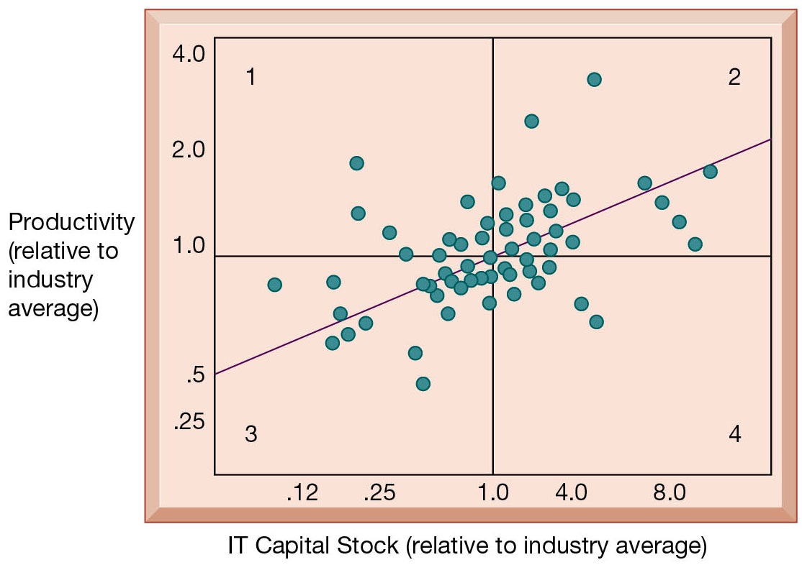
Figure 1.8 Variation in Returns on Information Technology Investment
Notes:
Figure 1.8, Page 24.
Although, on average, investments in information technology produce returns far above those returned by other investments, there is considerable variation across firms.
Source: Brynjolfsson, Erik and Lorin M. Hitt. “Beyond Computation: Information Technology, Organizational Transformation, and Business Performance.” Journal of Economic Perspectives 14, No. 4 (2000).
Emphasize that each quadrant of the graph represents a different type of firm.
Quadrant 1 represents firms that invest much less in IT but still receive strong returns.
Quadrant 2 represents firms that invest a great deal in IT and receive a great deal in returns.
Quadrant 3 represents firms that invest much less in IT and receive poor returns.
Quadrant 4 represents firms that invest a great deal in IT but receive poor returns.
Ask students where they want their firms to show up? The purpose of the course and book is to show students how to end up in top quadrant (2).
Alt Text
Long description: A scatterplot shows the productivity in relation to IT capital stock, relative to industry average.
The x-axis shows the IT capital stock, relative to industry average, ranging from 0.12 to 8. The y-axis shows the productivity, relative to industry average, ranging from 0.25 to 4. A horizontal line is drawn at 1 productivity and a vertical line is drawn at 1 IT capital stock, dividing it into 4 equal parts. The top left quadrant is labeled 1, the top right is labeled 2, the bottom left is labeled 3, and the bottom right is labeled 4. The graph shows that most of the values are concentrated between 0.5 and 2 productivity and 0.25 and 0.4 IT capital stock. Quadrant 1 and 4 have the least number of values. The trend line originates at 0.5 on the y-axis goes upwards and ends at 2.

Slide 43
Complementary Assets: Organizational Capital and the Right Business Model (2 of 2)
Complementary assets
  Examples of organizational assets
    Appropriate business model
    Efficient business processes
  Examples of managerial assets
    Incentives for management innovation
    Teamwork and collaborative work environments
  Examples of social assets
    The Internet and telecommunications infrastructure
    Technology standards
Notes:
Emphasize that firms that make significant investment in complementary assets tend to derive greater benefit from information technology investment than those that do not. Consideration of complementary assets should be a part of any firm’s broader view of how to create and implement their information systems. Stress to students that managers must consider dimensions such as complementary assets in order to derive benefit from information systems and be successful.

Slide 44
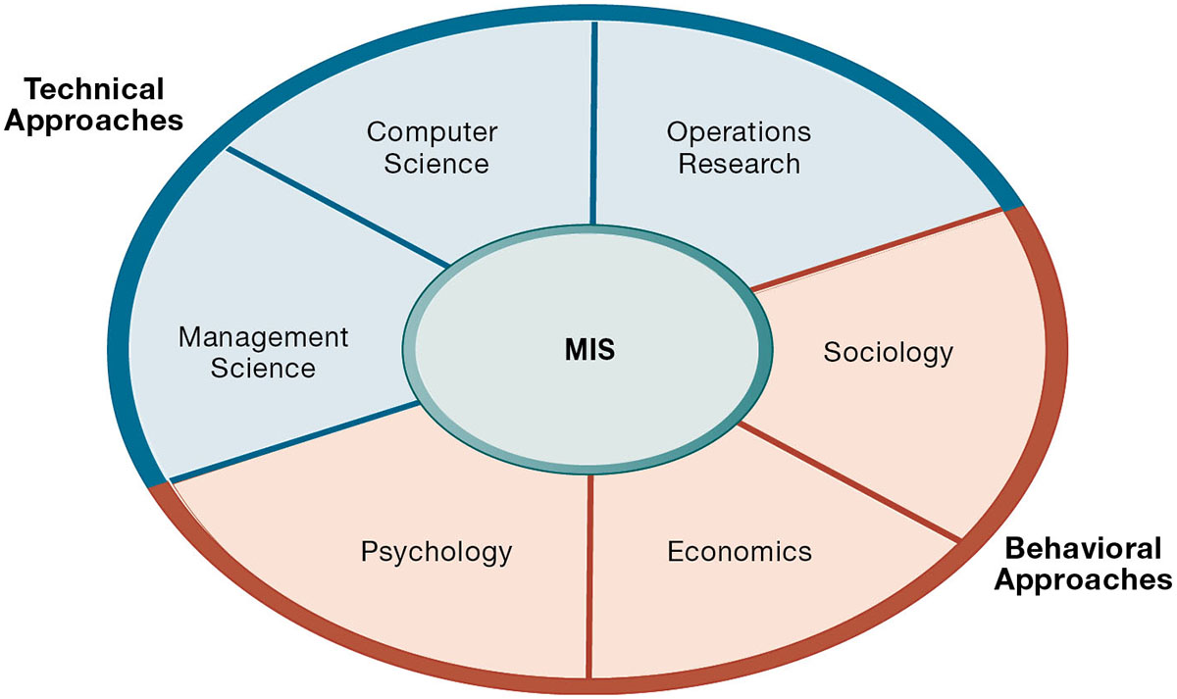
Figure 1.9 Contemporary Approaches to Information Systems
Notes:
Figure 1.9, Page 26.
The study of information systems deals with issues and insights contributed from technical and behavioral disciplines.
Ask students which of the two major types of approaches, behavioral and technical, they find to be most appropriate or accurate. Why do they feel this way? Emphasize that the technical approach does not ignore behavior and the behavioral approach does not ignore technology, but that they are indeed two distinct approaches.
Alt Text
Long description: A circular figure shows the technical approaches and behavioral approaches to MIS.
The figure shows the following:
Technical approaches: Management science. computer science, and operations research
Behavioral approaches: Sociology, economics, and psychology

Slide 45
Technical Approach
Emphasizes mathematically based models
Computer science, management science, operations research
Notes:
You might ask the students whether they think it’s possible to adopt only one of the two approaches to information systems and be successful. Then emphasize that the most accurate position is that there is no single approach that can truly capture the full scope and importance of information systems by itself.

Slide 46
Behavioral Approach
Behavioral issues (strategic business integration, implementation, etc.)
Psychology, economics, sociology

Slide 47
Approach of This Text: Sociotechnical Systems (1 of 2)
Management information systems
  Combine computer science, management science, operations research, and practical orientation with behavioral issues
Four main actors
  Suppliers of hardware and software
  Business firms
  Managers and employees
  Firm’s environment (legal, social, cultural context)
Notes:
Ask students to describe some of the relationships between the four main actors. For example, business firms look to acquire the components of their information systems from suppliers of hardware and software. The firm’s environment may dictate the type of software a company uses as well as the kind of employees that work there.

Slide 48
Approach of This Text: Sociotechnical Systems (2 of 2)
Sociotechnical view
  Optimal organizational performance achieved by jointly optimizing both social and technical systems used in production
  Helps avoid purely technological approach
Notes:
The critical aspect of this view is the balance between technological and social/behavioral concerns. Sometimes a lesser form of technology may be the best option because it is more suited to the personal needs of the individual, for example.

Slide 49
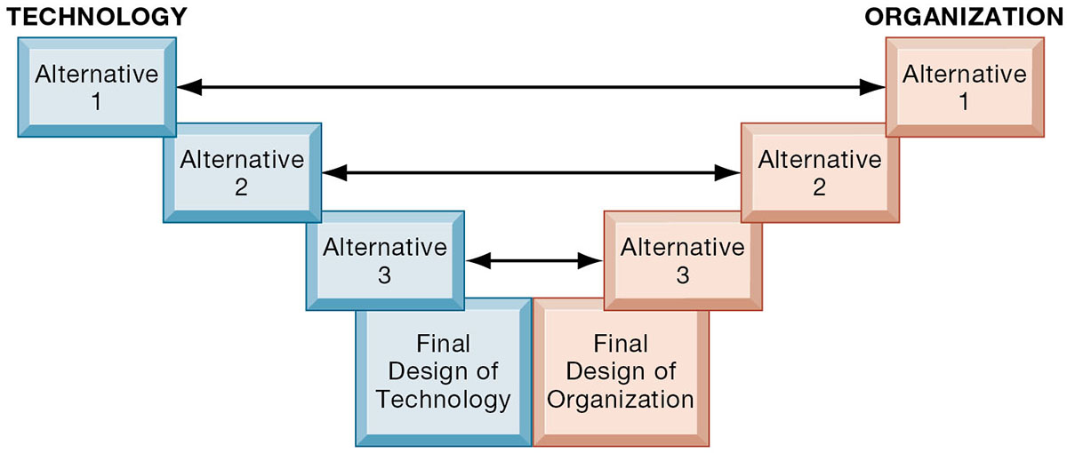
Figure 1.10 A Sociotechnical Perspective on Information Systems
Notes:
Figure 1.10, page 28.
In a sociotechnical perspective, the performance of a system is optimized when both the technology and the organization mutually adjust to one another until a satisfactory fit is obtained.
This graphic illustrates the interplay between technology and the organization. The two continue to grow closer together until an approach satisfying both perspectives is reached. Ensure that students understand that the two sides do not always need to form an equal compromise. Sometimes highly advanced technology may be more acceptable than at other times. As they will see with packaged software solutions and enterprise systems, firms are often required to change greatly in order to make the software applications work.
Alt Text
Long description: A figure illustrates the sociotechnical perspective on information systems. The figure shows a set of 3 alternatives each for technology and organization represented parallel to each other. The alternatives correspond to each other and as a result a final design of technology and final design of organization are obtained.

Slide 50
How Will MIS Help My Career?
The Company: Power Financial Analytics Data Services
Position: Financial client support and sales assistant
Job Requirements
Interview Questions
Author Tips
Notes:
A good opportunity for a class discussion on how MIS will help students with their current or future careers. Would any in the class be interested in a job like this? What do they think are the most important skills the employer is looking for? How would they answer the interviewer questions?

Slide 51

Copyright
This work is protected by United States copyright laws and is provided solely for the use of instructors in teaching their courses and assessing student learning. Dissemination or sale of any part of this work (including on the World Wide Web) will destroy the integrity of the work and is not permitted. The work and materials from it should never be made available to students except by instructors using the accompanying text in their classes. All recipients of this work are expected to abide by these restrictions and to honor the intended pedagogical purposes and the needs of other instructors who rely on these materials.

